Slide 1
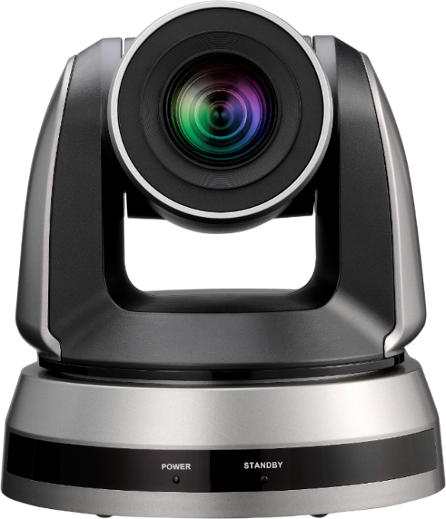
VC-TA50
AI Auto-Tracking Camera
Introduction

Slide 2




Overview
VC-TA50
FHD Auto Tracking Camera
Color: Black, White
NDAA/TAA Compliant: Yes
Warranty: 5-Year
MAP: $2,199

Slide 3
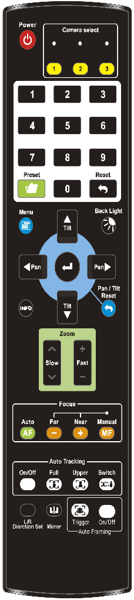
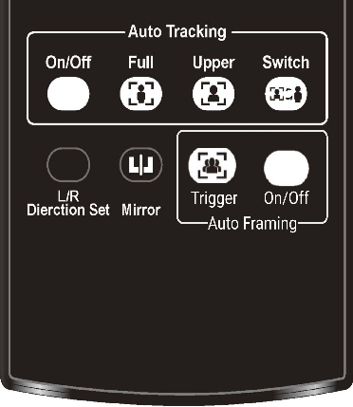
Product Design
Remote Controller
Lens
Pan Tilt Robotics
IR Receiver
Status LED

Slide 4
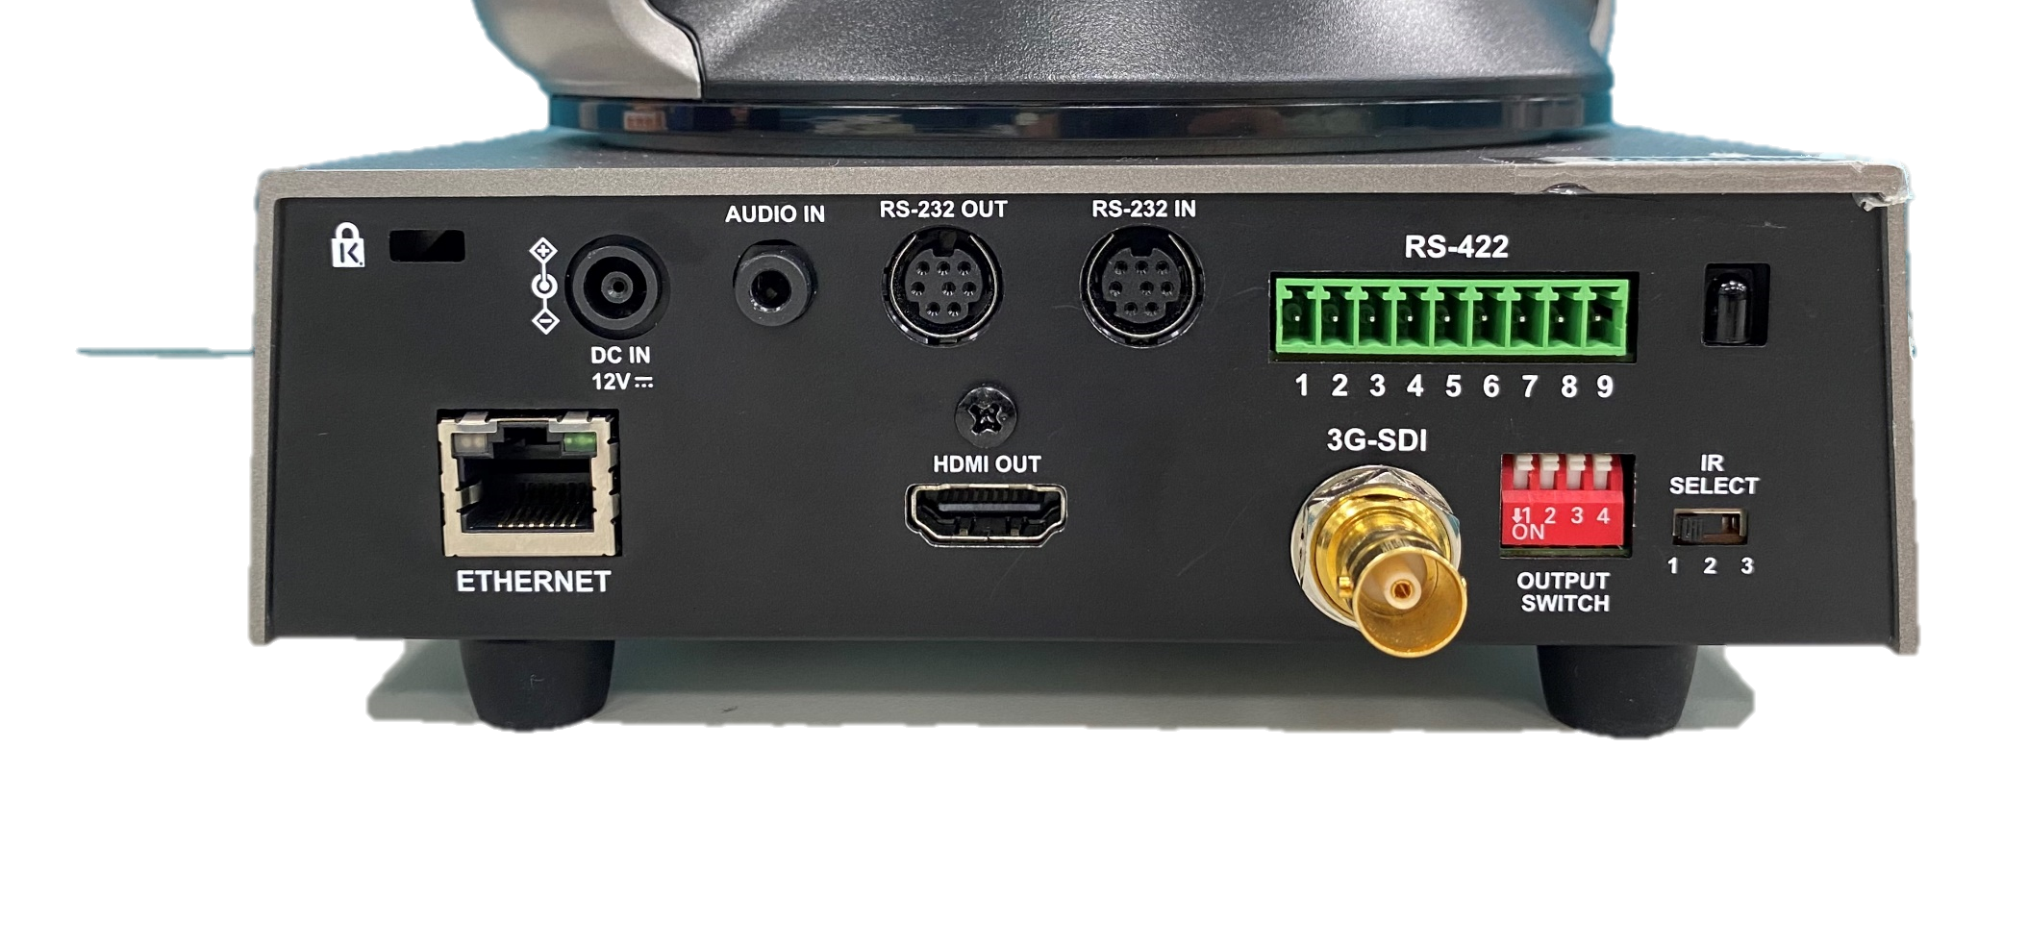
I/O Interface
Audio In
RS-232 (Daisy Chain)
RS-422
Kensington lock
Power Supply
Resolution Output
Dip Switch
IR Select
Ethernet
(PoE+)
HDMI
3G-SDI

Slide 5




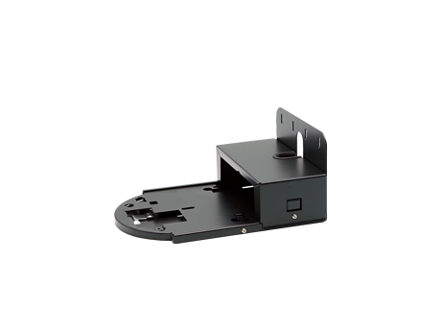
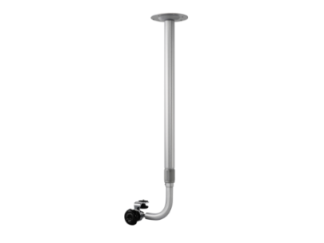

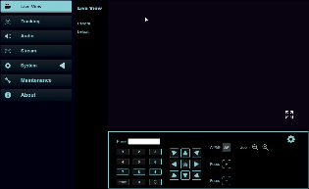
Accessories & Software
Software
Deployment Tool
Camera Controller
Virtual Camera
Accessories
Wall mount
WM12
Wall mount
WM15
Control
Remote Controller
Webpage

Slide 6

Key Features
AI-Powered Human Face Recognition
3 Tracking modes and auto framing
1080P 60fps with 20x Optical Zoom
HDMI, SDI, IP simultaneous output
Support RTSP/RTMP/RTMPS and SRT

Slide 7



Selling Points
Partition Tracking
(Hybrid Mode)
Everywhere Tracking
Stage Tracking
When inside the Tracking Area, the camera follows the presenter with only pan movement. When outside the Tracking Area, the camera stop following.
When inside a Partition Area, the camera displays a preset view and fixed in place. When outside Partition Areas, the camera follows the presenter by everywhere tracking.
The camera will follow the presenter wherever the presenter goes. You can track either full or upper body in view. You can simply change a tracking subject by clicking on him or her in web portal.

Slide 8
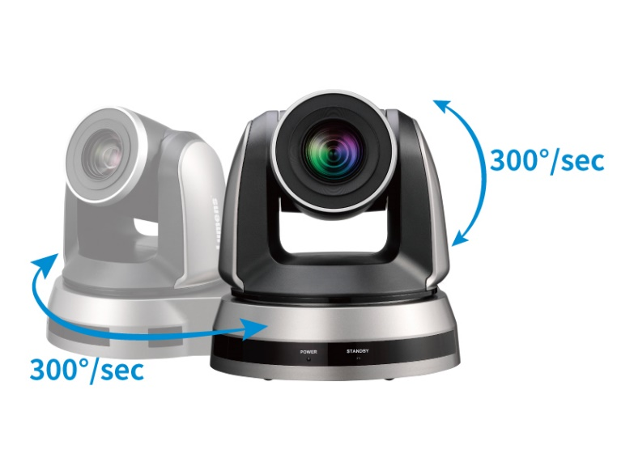

Selling Points
Smooth Pan-Tilt-Zoom movement
Smart AF
VC-TA50 offers smooth movement, panning, tilting, and zooming capabilities. Even in auto-tracking mode, this camera can perfectly move smoothly and track a subject.
Smart AF feature keeps your face in sharp focus even when you move around, so you can be sure that your pictures will always look amazing.

Slide 9

Auto-Tracking Features

Slide 10
Three Tracking Modes
  Stage Tracking
  Everywhere Tracking
  Partition Tracking
Auto-Framing
Advanced AI Function
  Click & Track
  Full/Upper Body
  People Counting
  Tracking ID
Tracking Features

Slide 11

Stage Tracking
How does it work:
When inside the Tracking Area, the camera follows the presenter with only pan movement. When outside the Tracking Area, the camera stop following.

Slide 12

Everywhere Tracking
How does it work:
The camera will follow the presenter wherever the presenter goes.

Slide 13

Partition Tracking (Hybrid Mode)
How does it work:
When inside a Partition Area, the camera will go to a designated preset position. When outside Partition Areas, the camera follows the presenter.

Slide 14

Auto-Framing
Camera will automatically frame all participants in view.

Slide 15
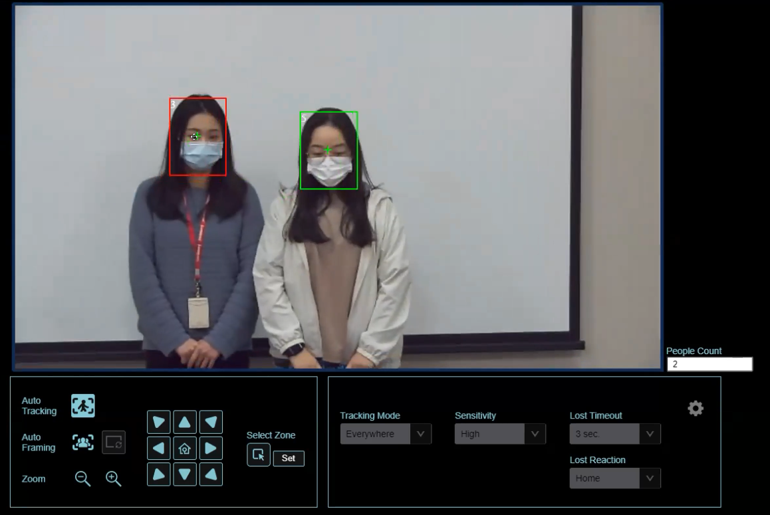
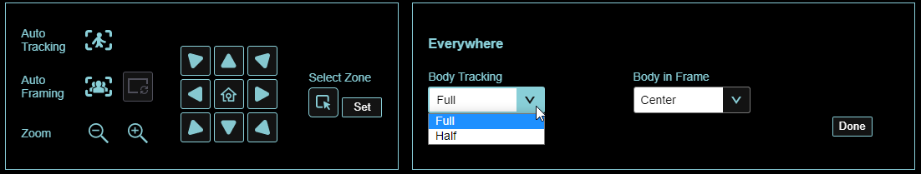
AI Advance Features
Click & Track
Full/Upper Body
People Counting
Tracking ID
Click & Track
Tracking
ID
People Counting
Full/Upper Body

Slide 16
Comparison

Slide 17
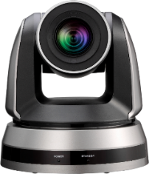
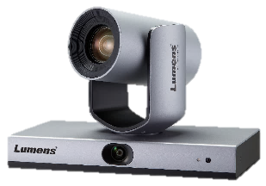
New VS Old
 | VC-TA50 | VC-TR1
Max Resolution | 1080p 60fps | 1080p 60fps
Optical Zoom | 20x | 20x
Lens | Single | Dual
Auto-Tracking Mode | 3 | 3
Auto-Framing Mode | 1 | 1
Click & Track |  | 
Full/Upper Body |  | 
Smart Switch |  | 
Multi-People Mode |  | 
Output | HDMI,SDI,IP | HDMI,SDI,IP,USB
Inverted Installation |  | 
Control | Webpage | Software

Slide 18
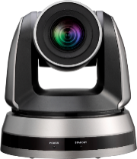
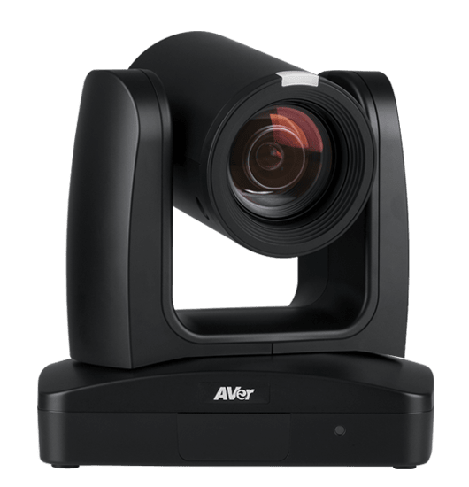
Competition
 | Lumens | Aver
Model | VC-TA50 | TR311
Map Price(USD) | $2,199 | $2,199
Video Format | 1080p60
Video Output (HD) Interface | 3G-SDI, HDMI, Ethernet | 3G-SDI, HDMI, Ethernet, USB3.0
Optical Zoom | 20x | 12x
Horizontal Viewing Angle | 57° | 70°
Smart AF | Yes | NA
Image Flip | Yes
AR/VR systems | FreeD | NA
Tally Light | Yes
Reliable AI Tracking | Yes | Yes
Auto Framing | Yes | NA
High Speed Preset | 300°/sec | 200°/sec
Smooth Pan/Tilt movement | Yes, 0.1°/s
USB Output | NA | 1080p30
IP Streaming | RTSP / RTMP / RTMPS / MPEG-TS / SRT | RTSP / RTMP / SRT
Control Protocol | VISCA / PELCO D / ONVIF | VISCA / PELCO-D / CGI (IP)
UVC | NA | Yes
UAC | NA | Yes

Slide 19



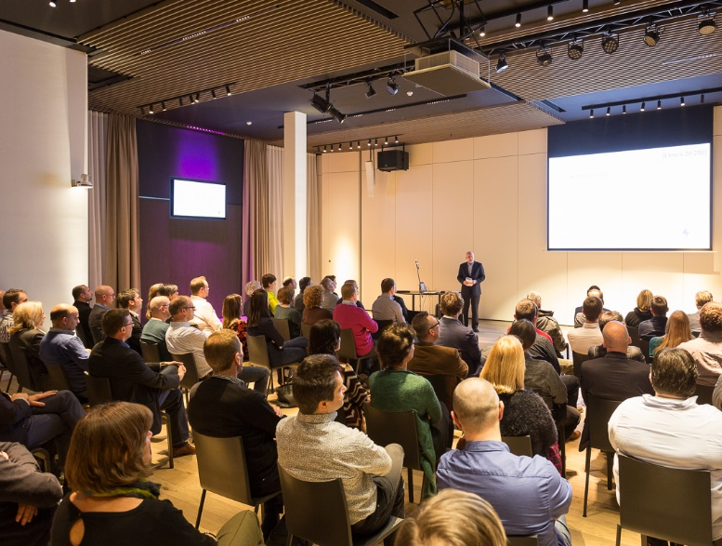
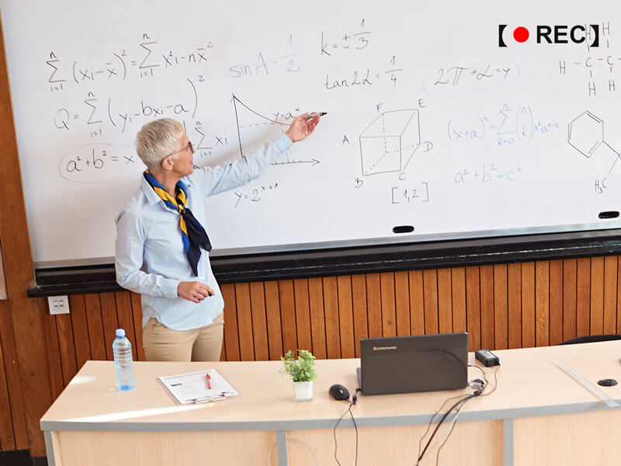
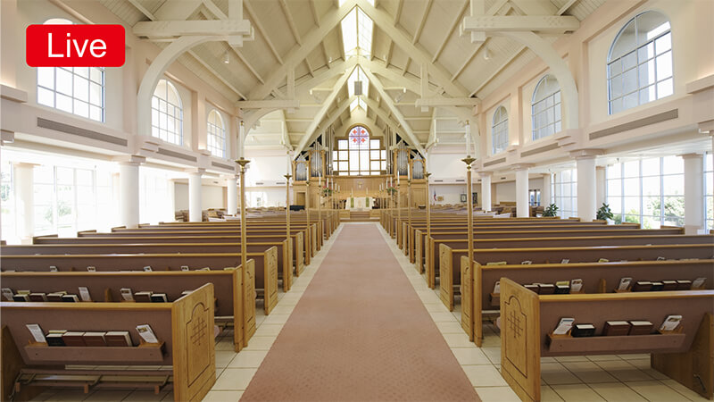
Use Cases
Corporate Training
Lecture Capture
House of worship

Slide 20
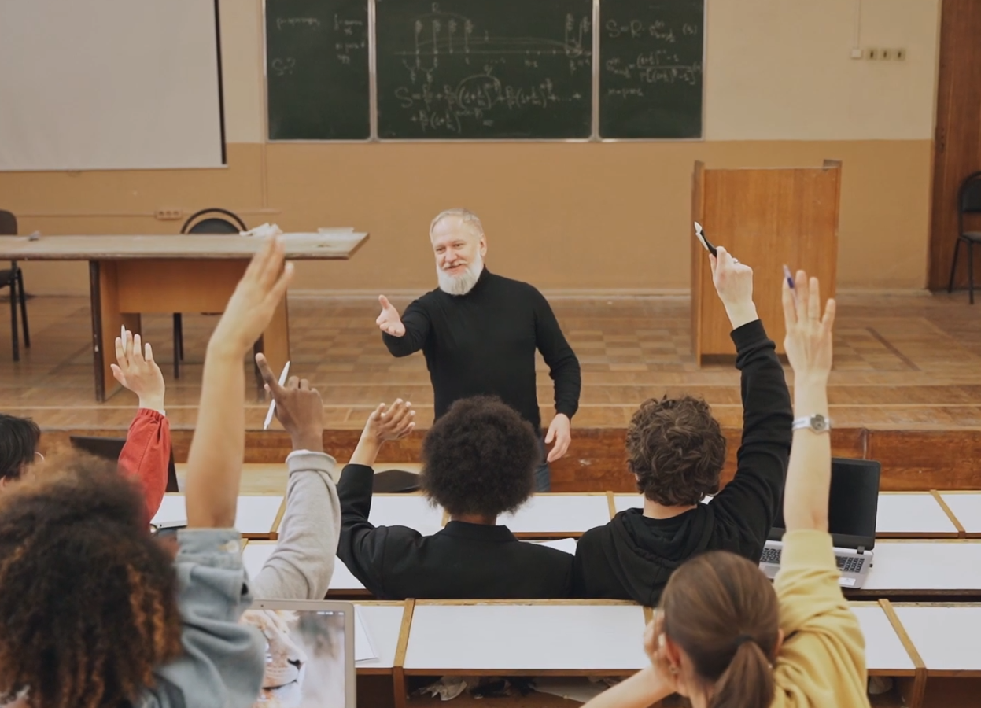
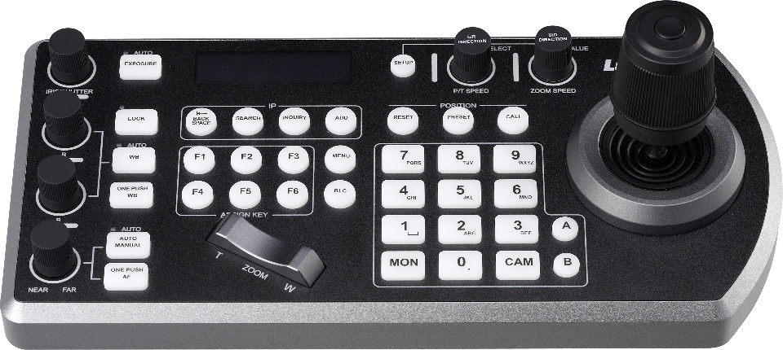
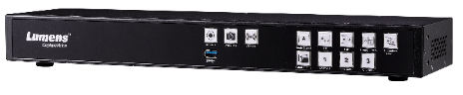
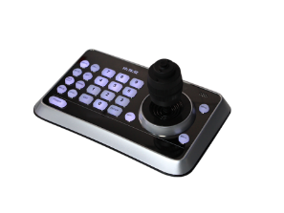
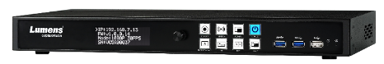
Integration
Lumens Product
VS-KB30
LC200
VS-K20
LC100
Control
Media Processor

Slide 21
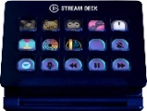
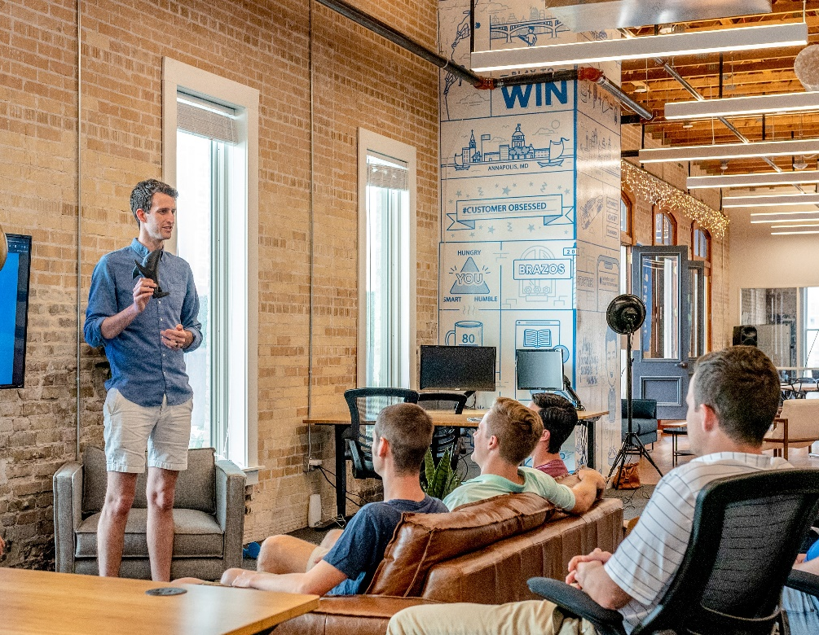










Integration
Third-Party
Stream Deck
Streaming Platform
Broadcasting Software

Slide 22







Standalone Live Streaming
Internet
RTP/RTMP/RTMPS
Network
Cat 5e
Line in / MIC in

Slide 23







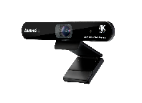


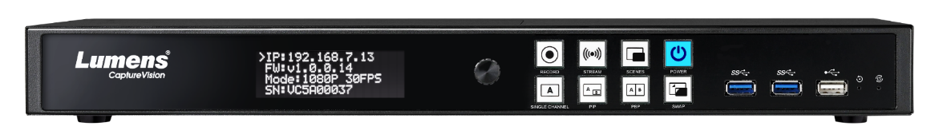
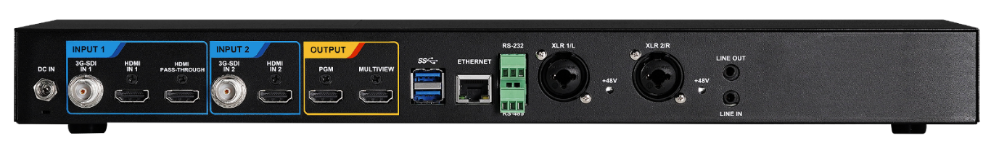
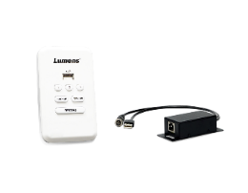


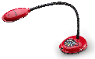
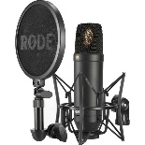
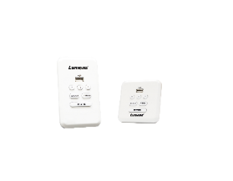

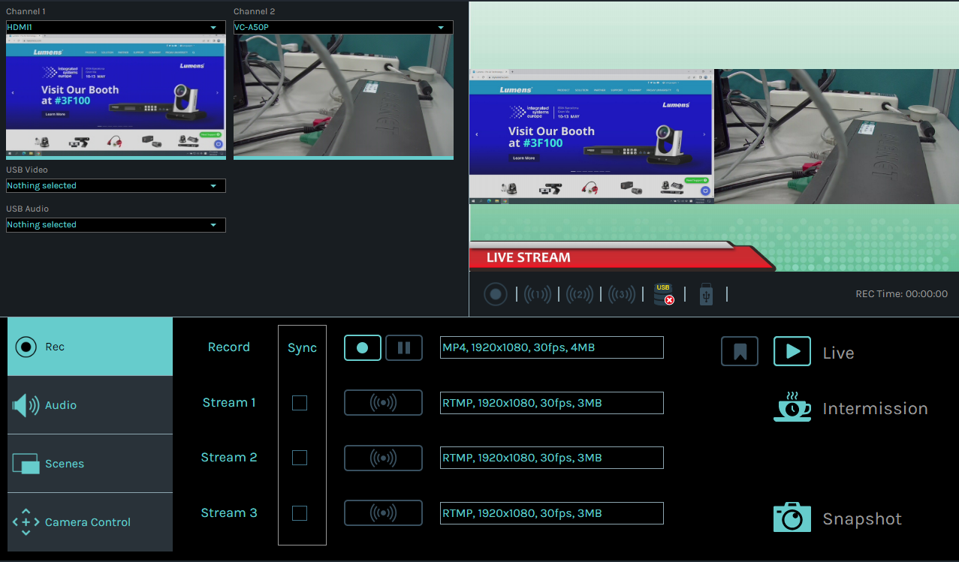
Recording and Streaming
Video Cloud Platform
Ethernet
Live Streaming
Cat 5e/6
Network
Ethernet
VC-TA50
USB
Corporate Server
USB
Ethernet
Cat 5e/6
Media Processor
LC100
HDMI Pass-thru
Audio In
HDMI
Audio Out
Extension Box
HDMI
Speaker
Content Laptop
Doc-cam
Remote Control Panel
Cat 5e/6
XLR Microphone
Onboard GUI Director

